Slide 1
In this lecture we’ll be looking at the difference between a sample distribution and a sampling distribution of a statistic
> set.seed(100)
> cards1<-c()
> for (i in 1:1000){cards1<-c(cards1,sample(2:10,1))}
> par(mfrow = c(2,2))
> hist(cards1)
> cards3<-c()
> for (i in 1:1000){cards3<-c(cards3,mean(sample(2:10,3,replace = TRUE)))}
> hist(cards3)
REVIEW

Slide 2
> cards8<-c()
> for (i in 1:1000){cards8<-c(cards8,mean(sample(2:10,8,replace = TRUE)))}
> hist(cards8)
> cards30<-c()
> for (i in 1:1000){cards30<-c(cards30,mean(sample(2:10,30,replace = TRUE)))}
> hist(cards30)
REVIEW

Slide 3
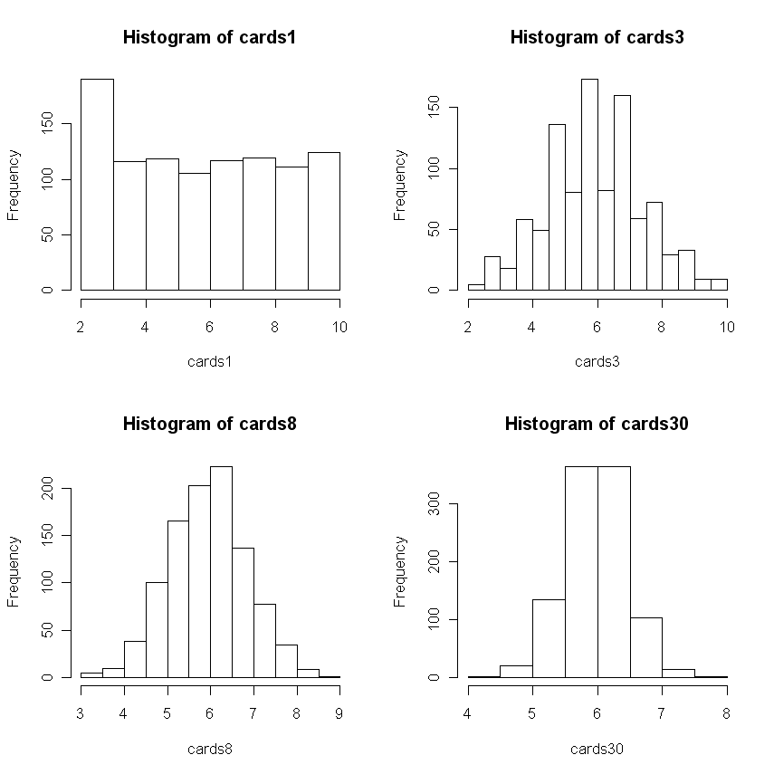
REVIEW

Slide 4
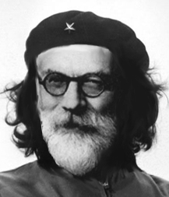
Guerilla statistics:
Basic Training
Episode 4: Sampling Distributions and Hypothesis Testing
Howell: 92-112
BHH2: 39-46
Or
How Not to Be Lied to with Statistics

Slide 5
Using the normal distribution to test hypotheses
What percentage of scores is at or above a given score value of 115 on an IQ test? IQ tests are standardized, with μ = 100, σ = 15. Z = (115 - 100)/15 = 1.00. You can then integrate the normal curve from one to infinity, use a computer index or go to a z-score table. On page 759 find the row with Z = 1.00. The entry under “Smaller Portion” is the answer, .1587 or 15.87%.
What percentage of persons have IQ’s between 85 and 130? The Z-scores are ‑1.00 and +2.00. Between the ‑1.00 and the mean are 34.13%, with another 47.72% between the mean and +2.00, for a total of 81.85%.

Slide 6

Probability and the normal curve
Suppose you are an extraterrestrial researcher who has quite a collection of human astronauts who, unbeknownst to you, are all male.
You know the mean of the heights of those in your collection is η = 175 cm and the standard deviation is σ = 7.
You suspect that a new astronaut—clearly human, but with a different shape and height (unbeknownst to you, this astronaut is a female) —is a different kind of human. What’s the probability that an astronaut from the known (male) population would be 162 cm or shorter?
> z<-(162-175)/7
> z
[1] -1.857143
> pnorm(z)
[1] 0.03164542

Slide 7


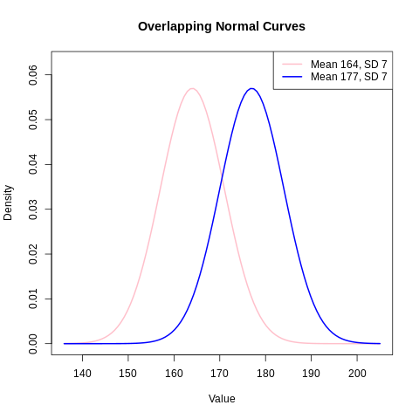
What if we know the parameters of two overlapping distributions?
Again, suppose our alien researcher knows the heights of men and women (177 and 162 cm, with identical standard deviations), but otherwise hasn’t figured out how to sex them, short of dissection. A new specimen comes in and is 164 cm tall. Is it more likely that this is a female specimen or a male?
We can do the z test in one of two ways:

Slide 8
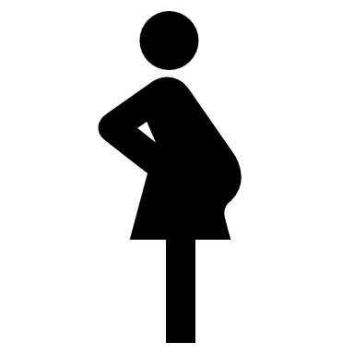
What if we know the parameters of two overlapping distributions?
Again, suppose our alien researcher knows the heights of men and women (177 and 162 cm, with identical standard deviations), but otherwise hasn’t figured out how to sex them, short of dissection. A new specimen comes in and is 164 cm tall. Is it more likely that this is a female specimen or a male?
We can do the z test in one of two ways:
The smaller of the two z scores indicates that the observed value is closer to that distribution’s center.
The height of the curve at point x tells gives us information about its likelihood (though not its specific probability), and the ratio of likelihoods tells us how much more likely it is that this entity is a female
> dnorm((164-162)/7)
[1] 0.3829868
> dnorm((164-177)/7)
[1] 0.07111704
> dnorm((164-162)/7)/dnorm((164-177)/7)
[1] 5.385302
Of course, it is possible that our decision is incorrect, and mistakenly putting a male in with the females can lead to many more humans 10 months down the road. COSTS and BENEFITS

Slide 9
Signal detection
Many situations in the real world involve decisions that can be characterized as detecting a signal in noise, or ambiguous information
  Radiologists
  Parts defects
  Terrorist detection
Diagnostic decision sciences examine sensitivity, how much signal and noise distributions overlap:
  d-prime (d’): the difference in means divided by the pooled standard deviation of the distributions
Diagnostic decision sciences also examine bias
  The cost of missing a tumor may make the decision “tumor” more likely in the face of ambiguous evidence
  The prior probabilities also may introduce bias

Slide 10
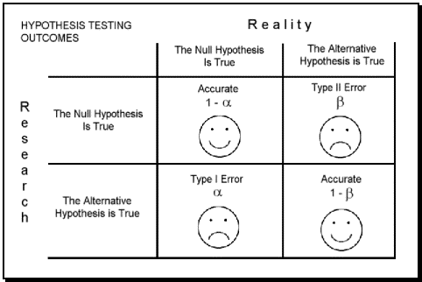
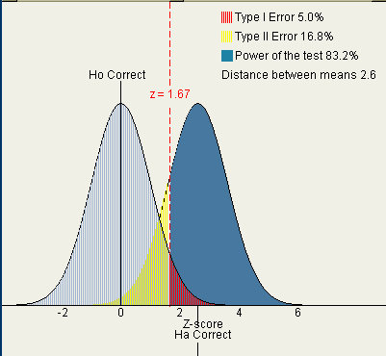
Errors, Types 1 and 2
The two kinds of mistakes we can make have many real world instantiations
Type 1 error – alpha, α
Type 2 error - Beta, β
1- β=power
Two-tailed (nondirectional) vs. one-tailed (directional) tests
http://www.intuitor.com/statistics/T1T2Errors.html

Slide 11
What about for a sample mean?
As we saw at the beginning, distributions of sample means are going to be tighter and more normal than the parent distributions.
Specifically, we use the same test formulas but divide the standard deviation by the square root of the sample size.
Suppose our alien researcher has captured a spaceship with a crew of 4 of these new, funny shaped humans. Their mean height is, again, 162 cm.
The null hypothesis is that the mean of this new sample will equal the old.
> z<-(162-175)/3.5
> pnorm(z)
[1] 0.0001018892
This is what some researchers would call “highly significant” support for the alternative hypothesis. In other words, it is very unlikely that we would draw a random sample of 4 men that would have a mean height of 162cm
Issues of random sampling and recognizable subsets

Slide 12
Sampling error
We expect the value of a simple statistic to deviate from the parameter it is estimating, simply by chance alone
Doob & Gross (1968)- Rude motorists:
Are we less likely to honk at a Lexus?
  Beat up car: 84%
  Expensive car: 50%
What accounts for this difference? Either:
  There is a real and reliable difference in the propensity to honk as a function of type of car
  The difference is accidental, due to sampling error
Thus, a key factor is going to be sample size

Slide 13
Sampling distributions
Sampling distributions tell us the degree of sample to sample variability we can expect by chance alone
According to BHH2: “the investigator must in some way produce a relavant reference distribution that represents a characteristic set of outcomes that could occur if the modification [manipulation] was entirely without effect. The actual outcome may then be compared with this reference set. If it is found to be exceptional, the result is called statistically significant.”

Slide 14
Hypothesis testing
We generally have a research hypothesis of the following form
  People in the treatment group will score differently (two-tailed) or higher (one-tailed) on an ability test than people without the treatment (control)
  The Null Hypothesis is that the sample mean Xbar = the population mean μ₀
Assuming we know the μ₀ and σ for the population:
1-obtain a random sample, administer the treatment, get Xbar
2-obtain/estimate the sampling distribution of the population mean for sample size n
3-find the score in this sampling distribution of the null that corresponds to the value of the sample mean.
The probability associated with this score is the probability that you obtained your sample mean by chance alone

Slide 15
More on null hypothesis testing
Fisher introduced the concept: while we can never prove that anything is true, we can prove that things are false
  All swans are white
Of course, you can’t prove that the null is true, either
In fact, the exact null hypothesis is never likely to be true
Fisher concluded that a nonsignificant result was an inconclusive result
Neyman-Pearson (1933): hypothesis testing is a game; if we fail to reject the null we act like its true

Slide 16
AGAIN: Testing hypotheses about means with σ known
Recall that we could test hypotheses about the likelihood that a single observation came from a distribution of observations:
We can also test hypotheses about the likelihood that a sample mean Xbar came from a distribution of sample means.
Note again that the sampling distribution of the mean is tighter (and more normal) than the distribution of the raw observations.

Slide 17

Measures of Dispersion
The Variance
  Population: σ²
  Sample: s²

Slide 18
A closer look at bias: Sample variance
Degrees of freedom
  If we know the mean, how many scores are free to vary?
  Knowing the mean and (n-1) scores, we know (can calculate) the last score

Slide 19
Testing a Sample Mean When σ is unknown-
The One Sample t Test
If we have to estimate the variance of the population with our data, we have to use s², the unbiased estimate.
This also requires evaluating our test statistic against the t distribution.

Slide 20
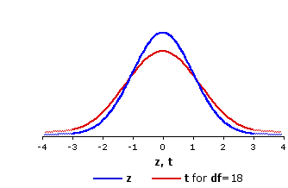
More on the t-distribution
Student’s t-distribution (pseudonym of W.S. Gosset, statistician for Guiness brewery; 1908) is fatter in the tails relative to the normal curve, reflecting the greater uncertainty inherent in a smaller sample
n=∞ P(t > 2) = 2.3%
n=9 P(t > 2) = 3.8%
n=6 P(t > 2) = 4.6%
n=4 P(t > 2) = 5.8%
n=3 P(t > 2) = 7.0%
n=2 P(t > 2) = 9.2%
n=1 P(t > 2) = 14.8%

Slide 21
Testing a Sample Mean When σ is unknown-
The One Sample t Test
If we have to estimate the variance of the population with our data, we have to use s², the unbiased estimate. This also requires evaluating our test statistic against the t distribution.

Slide 22
Testing a Sample Mean When σ is unknown-
The One Sample t Test
If we have to estimate the variance of the population with our data, we have to use s², the unbiased estimate. This also requires evaluating our test statistic against the t distribution.

