Slide 1
Recall
According to BHH2: “the investigator must in some way produce a relevant reference distribution that represents a characteristic set of outcomes that could occur if the modification [manipulation] was entirely without effect. The actual outcome may then be compared with this reference set. If it is found to be exceptional, the result is called statistically significant.” (p. 68)
REVIEW

Slide 2
Testing a Sample Mean When σ is unknown-
The One Sample t Test
If we have to estimate the variance of the population with our data, we have to use s², the unbiased estimate. This requires evaluating our test statistic against the t distribution.

Slide 3

Guerilla statistics:
Basic Training
Episode 5: T-Tests
Howell: 178-217
BHH2:
Or
How Not to Be Lied to with Statistics

Slide 4
Confidence intervals on μ_{a}
X_bar is an unbiased point estimate for μ_{a} (this is not mu under the null)
But it’s seldom exactly right. What interval is 95% likely to contain μ_{a}?
From the moon data:
We also know that a two-tailed t at α = .05 is t_{.025}(9) = ±2.262
We can now solve for the mu associated with this t:
Note that mu isn’t varying from experiment to experiment, the interval is

Slide 5
Basic laws of probability
Additive rule: given a set of mutually exclusive events, the probability of one or another occurring is equal to the sum of their individual probabilities
Mutliplicative rule: The probability of the joint occurrence of two or more independent events is equal to the product of their individual probabilities
Sampling with and without replacement
Joint probabilities: p(A,B)
Conditional probabilities: p(A|B)

Slide 6
Permutations and combinations
If we have 4 things sampled without replacement, how many different orders might we sample them in? This is a permutation, with N number of things taken r at a time (note that 0! = 1):
If order isn’t important, we are interested in combinations

Slide 7
The exact Sampling distribution
Given the data at the left, what is the sampling distribution of X_bar for n=4?
  You need to generate every combination of 4 values

Slide 9
Hypothesis tests applied to means—Matched or Paired Samples
If we have measures on the same subjects in both a control and experimental condition, we may analyze the difference scores

Slide 10
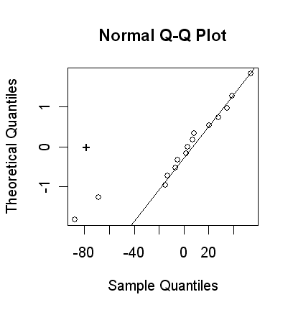
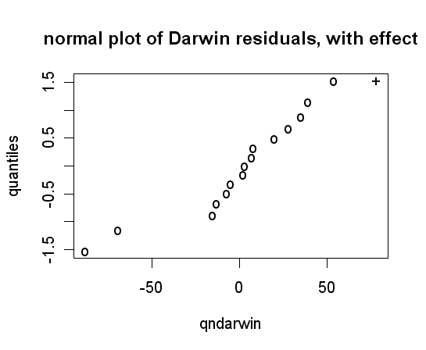
Graphical ANOVA: Darwin data
darwin<-c(49,-67,8,16,6,23,28,41,14,29,56,24,75,60,-48)
ndarwin<-darwin-mean(darwin)
qqnorm(ndarwin,datax=TRUE)
qqline(ndarwin,datax=TRUE)
points(-20.9*14^.5,0,pch="+")
> qndarwin<-c(sort(ndarwin), 20.9*14^.5)
> quantiles<-qnorm(v/(length(ndarwin)+1))
> quantiles<- c(quantiles, qnorm(length(ndarwin)/ (length(ndarwin)+1)))
> plotPoints<-c(rep("o",15),"+")
> plot(qndarwin,quantiles, main="normal plot of Darwin residuals, with effect",pch=plotPoints)

Slide 11
Portland Cement Formulation (Montgomery, page 23)

Slide 12
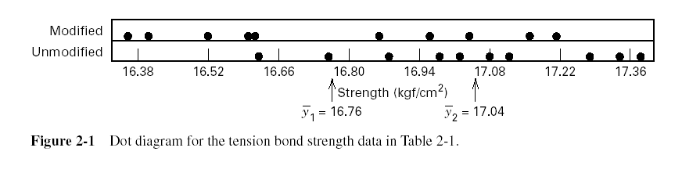
Graphical View of the Data
Dot Diagram, Fig. 2-1, pp. 24

Slide 13
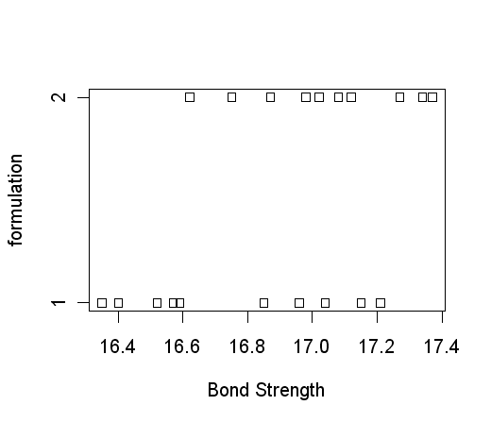
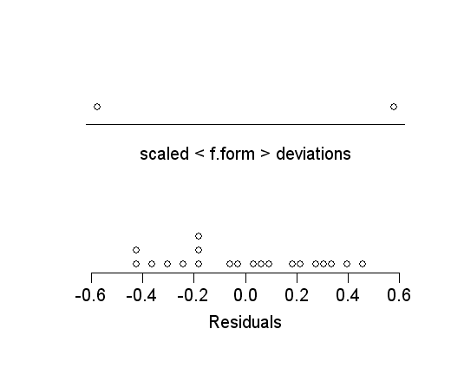
> bond<-c(16.85,16.4,17.21,16.35,16.52,17.04,16.96,17.15,16.59,16.57,16.62,16.75,17.37,17.12,16.98,16.87,17.34,17.02,17.08,17.27)
> form<-c(rep(1,10),rep(2,10))
> help(stripchart)
> stripchart(bond~form)
> library(BHH2)
> anovaPlot(lm(bond~form))
Warning message:
non-factors ignored: form in: replications(paste("~", xx), data = mf)
> f.form<-factor(form)
> anovaPlot(lm(bond~f.form))

Slide 14
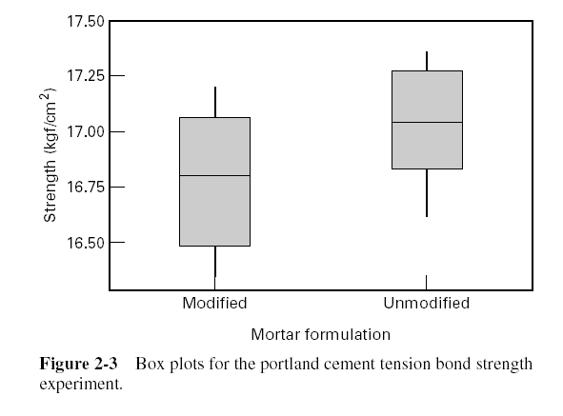
Box Plots, Fig. 2-3, pp. 26

Slide 15
How the Two-Sample t-Test Works:

Slide 16
Independent samples
Distribution of differences between means: μ₁ – μ₂
The Standard Error Of Differences Between Means is
But because these samples are independent, we assume rho = 0

Slide 17
How the Two-Sample t-Test Works:

Slide 18
How the Two-Sample t-Test Works:
Values of t₀ that are near zero are consistent with the null hypothesis
Values of t₀ that are very different from zero are consistent with the alternative hypothesis
t₀ is a “distance” measure-how far apart the averages are expressed in units that correspond to the standard deviation of the sampling distribution (i.e. the standard error of the sample mean)
Notice the interpretation of t₀ as a signal-to-noise ratio

Slide 19
The Two-Sample (Pooled) t-Test

Slide 20
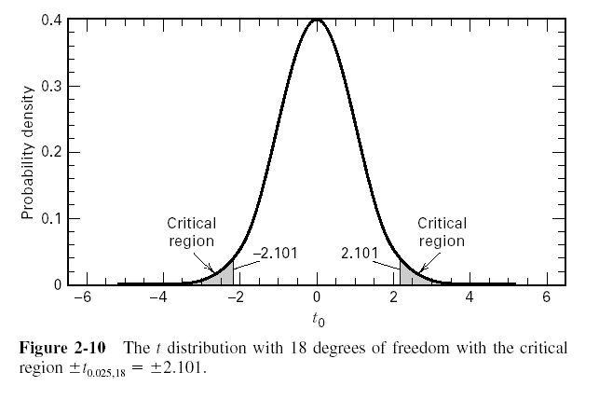
The Two-Sample (Pooled) t-Test
So far, we haven’t really done any “statistics”
We need an objective basis for deciding how large the test statistic t₀ really is
In 1908, W. S. Gosset derived the reference distribution for t₀ … called the t distribution
t₀ = -2.20

Slide 21
The Two-Sample (Pooled) t-Test
A value of t₀ between –2.101 and 2.101 is consistent with equality of means
It is possible for the means to be equal and t₀ to exceed either 2.101 or –2.101, but it would be a “rare event” … leads to the conclusion that the means are different
Could also use the P-value approach
t₀ = -2.20

Slide 22
The Two-Sample (Pooled) t-Test
t₀ = -2.20
The P-value is the risk of wrongly rejecting the null hypothesis of equal means (it measures rareness of the event). The P-value in our problem is P = 0.042

Slide 23
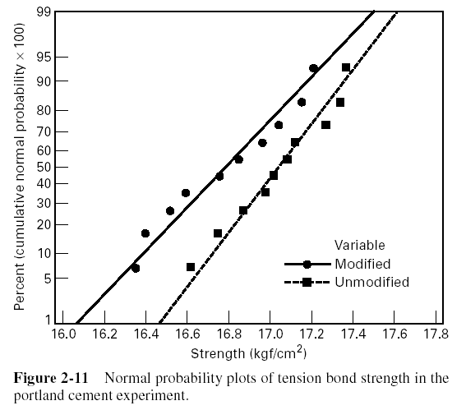
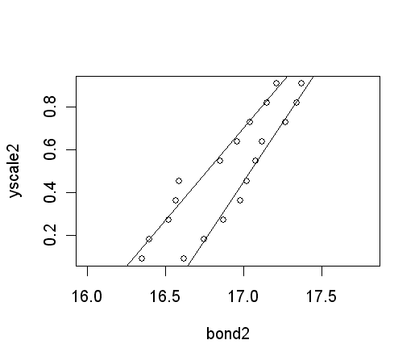
Checking Assumptions –
The Normal Probability Plot
> ser1<-seq(1:10)
> yscale<-pnorm(qnorm(ser1/11))
> yscale2<-c(yscale,yscale)
> form1<-sort(bond[1:10])
> form2<-sort(bond[11:20])
> bond2<-c(form1,form2)
> plot(bond2,yscale2, xlim=c(16.0,17.8))
> abline(lm(yscale~form1))
> abline(lm(yscale~form2))
These qqlines aren’t quite right, but sufficient for a visual check of assumptions

Slide 24
> qqnorm(form1, datax=TRUE)
> summary(lm(bond~f.form))
    Call:
    lm(formula = bond ~ f.form)
    Residuals:
    Min 1Q Median 3Q Max
    -0.4220 -0.2065 0.0080 0.2400 0.4460
    Coefficients:
    Estimate Std. Error t value Pr(>|t|)
    (Intercept) 16.76400 0.08989 186.497 <2e-16 ***
    f.form2 0.27800 0.12712 2.187 0.0422 *
    ---
    Signif. codes: 0 '***' 0.001 '**' 0.01 '*' 0.05 '.' 0.1 ' ' 1
    Residual standard error: 0.2843 on 18 degrees of freedom
    Multiple R-Squared: 0.2099, Adjusted R-squared: 0.166
    F-statistic: 4.782 on 1 and 18 DF, p-value: 0.0422
> mean(form1)
[1] 16.764
> mean(form2)
[1] 17.042
> mean(form2)-mean(form1)
[1] 0.278

Slide 25
Computing the pooled error
> Var1<-(sd(form1))^2
[1] 0.1001378
> Var2<-(sd(form2))^2
[1] 0.06146222
VarPooled<-((df1*Var1)+(df2*Var2))/(df1+df2)
Sp<-VarPooled^.5
tStat<- (Xbar1-Xbar2)/(Sp*(1/n1 +1/n2)^.5)

Slide 26
Confidence Intervals
Hypothesis testing gives an objective statement concerning the difference in means, but it doesn’t specify “how different” they are
General form of a confidence interval
The 100(1- α)% confidence interval on the difference in two means:

Slide 27
Another two group t test example

Slide 28
Matched pairs as a design strategy (Blocking)

Slide 29
Effect sizes
Cohen developed a measure that would tell us something about the magnitude of an experimental effect:
The point-biserial r² tells us the proportion of variability in the data that can be accounted for by the manipulation

Slide 30
Fixed vs. Random I.V.s
Testing the efficacy of drug X might be accomplished with a double blind, random assignment to Drug X (treatment) or placebo (control).
This variable is FIXED by the experimenter.
What if we want to investigate differences in math achievement in people who score high or low on a test of verbal ability?
We can’t manipulate this variable. This is a RANDOM variable. Any relationship that you discover might not be caused by you I.V.
EG, What if we want to investigate differences in math achievement in men vs. women?
We can’t manipulate this variable, either. If men score significantly higher than women, we can’t say that gender causes math ability. Alternative explanations exist.
We can nevertheless use statistical inference with RANDOM variables.

